Slide 1

Lords Institute of Engineering and Technology
Department of Computer Science and Engineering
Multi-Agent AI Platform for Autonomous Enterprise Workflow Orchestration
Presented by:
VijayaLakshmi - 160923733082
Qudsia Mehraj - 160923733111
Academic year 2026 - 2027

Slide 2

Contents
01 Introduction
08 Workflow walkthrough
02 Problem statement
09 Knowledge module (RAG)
03 Objectives
10 Security and reliability
04 Literature review (detailed)
11 Technology stack
05 Existing vs proposed system
12 Outcomes and future scope
06 System architecture
13 Conclusion and references
07 Agents and modules
Lords Institute of Engineering and Technology | Department of Computer Science and Engineering

Slide 3
Introduction
In every company, a simple request like a new laptop passes through many people: employee, manager, IT, finance and stores.
Each step means emails, forms and waiting. The process is slow and mistakes creep in.
A chatbot can answer questions, but it cannot run a whole process from start to finish.
Our idea: A team of AI agents, each with one job, led by an Orchestrator Agent.
We test it on IT Service Management (ITSM): laptop replacement and procurement requests.
Lords Institute of Engineering and Technology | Department of Computer Science and Engineering

Slide 4
Problem Statement
One AI model alone cannot manage a long process with many steps.
Existing agent tools give no control over who can do what, and keep no audit trail.
AI often guesses instead of following company policy.
Risky decisions need a human to approve, but most tools skip this.
If one step fails, the whole process stops. There is no retry.
Core question
How can many AI agents run a business process on their own, and still stay safe, controlled and accountable?
Lords Institute of Engineering and Technology | Department of Computer Science and Engineering

Slide 5
Objectives
Build a team of agents, each with one clear job.
Create an Orchestrator Agent that splits a request into tasks and tracks each one.
Let the admin design workflows with conditions, approvals and backup steps.
Make agents follow company rules using RAG on policy documents.
Add human approval, role-based access, audit logs and monitoring.
Handle failures with retry and fallback, and show workflow analytics.
Lords Institute of Engineering and Technology | Department of Computer Science and Engineering

Slide 6

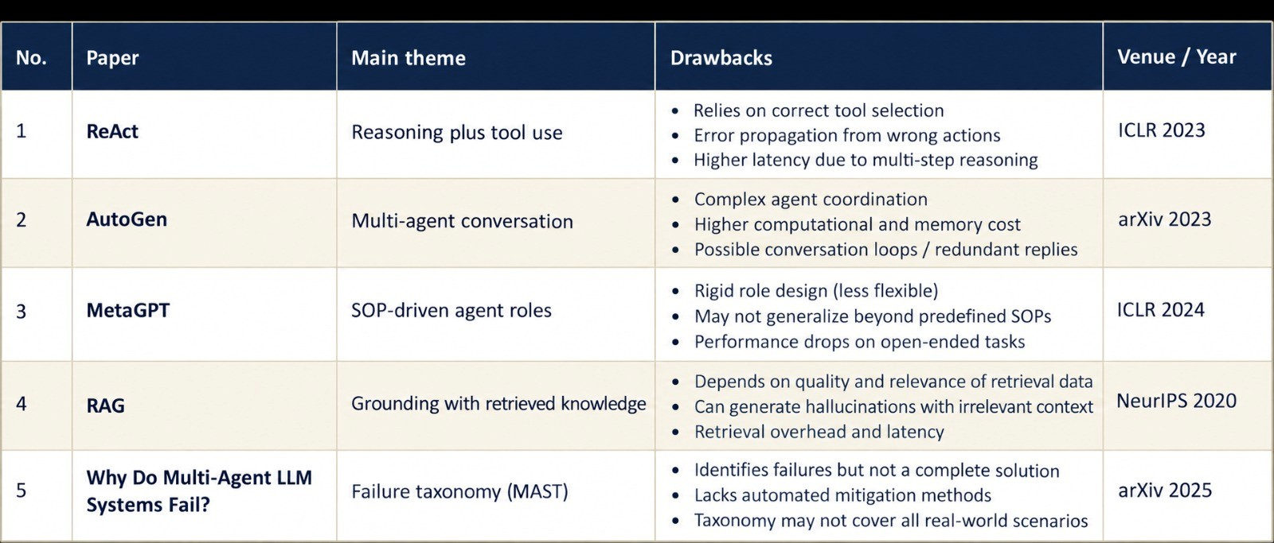
Literature Review: Overview
Lords Institute of Engineering and Technology | Department of Computer Science and Engineering

Slide 7
Paper 1: ReAct (Yao et al., ICLR 2023)
ReAct: Synergizing Reasoning and Acting in Language Models
PROBLEM ADDRESSED
LLMs either reason (chain-of-thought) or act (use tools), but not both together.
Reasoning alone hallucinates facts; acting alone has no plan.
APPROACH
Prompts the model to alternate Thought, Action, Observation steps.
Actions call tools such as a Wikipedia API, so answers use real data.
KEY FINDINGS
Fewer hallucinations than chain-of-thought on HotpotQA and FEVER.
Beat imitation and RL baselines on ALFWorld (+34%) and WebShop (+10%).
LIMITATIONS
Works as one agent holding the whole task in a single context.
Early errors carry forward in long tasks.
Tested on QA and games, not on business workflows.
RELEVANCE TO OUR PROJECT
We keep its tool-calling idea inside every agent.
But the work is split across specialised agents, not one.
Lords Institute of Engineering and Technology | Department of Computer Science and Engineering

Slide 8
Paper 2: AutoGen (Wu et al., 2023)
AutoGen: Enabling Next-Gen LLM Applications via Multi-Agent Conversation
PROBLEM ADDRESSED
Complex LLM applications need several agents with different skills.
Building such setups was ad hoc and hard to reuse.
APPROACH
Conversable agents that can be LLMs, humans or tools.
Conversation programming: flow is set using both natural language and code.
KEY FINDINGS
Shown on math, coding, question answering and decision making.
Makes it easy to bring a human into the agent conversation.
LIMITATIONS
Agents coordinate mainly by free-form chat, so runs can vary or loop.
Access control, audit trail and workflow state are left to the developer.
RELEVANCE TO OUR PROJECT
We adopt multi-agent collaboration.
But replace open chat with an Orchestrator and structured JSON messages.
Lords Institute of Engineering and Technology | Department of Computer Science and Engineering

Slide 9
Paper 3: MetaGPT (Hong et al., ICLR 2024)
MetaGPT: Meta Programming for a Multi-Agent Collaborative Framework
PROBLEM ADDRESSED
Chaining LLM agents causes logic gaps and cascading hallucinations.
Plain chat between agents is noisy and hard to verify.
APPROACH
Encodes human SOPs into prompts; roles like product manager, architect, engineer, QA.
Agents hand over standard documents, like an assembly line.
KEY FINDINGS
More consistent software output than earlier chat-based agents.
Strong results on code benchmarks such as HumanEval and MBPP.
LIMITATIONS
Roles and SOPs are hard-coded for software development.
Admins cannot define new workflows; no approvals or enterprise system links.
RELEVANCE TO OUR PROJECT
We keep the SOP idea: every workflow is a defined procedure.
But make it admin-configurable, with approvals, fallbacks and an Agent Registry.
Lords Institute of Engineering and Technology | Department of Computer Science and Engineering

Slide 10
Paper 4: RAG (Lewis et al., NeurIPS 2020)
Retrieval-Augmented Generation for Knowledge-Intensive NLP Tasks
PROBLEM ADDRESSED
LLMs keep knowledge in their weights: hard to update and no source to check.
They hallucinate on knowledge-heavy questions.
APPROACH
Combines a generator (BART) with a retriever over a dense Wikipedia index.
Retrieved passages are given to the model before it answers.
KEY FINDINGS
State-of-the-art on open-domain QA such as Natural Questions.
More factual and specific text than a model without retrieval.
LIMITATIONS
Built on a general corpus, not private company data.
It only writes answers; it takes no action.
A wrong retrieval gives a wrong answer, and nothing checks policy compliance.
RELEVANCE TO OUR PROJECT
Our Knowledge module applies RAG to HR, IT and procurement policies.
A Compliance Agent verifies decisions before the Execution Agent acts.
Lords Institute of Engineering and Technology | Department of Computer Science and Engineering

Slide 11
Paper 5: MAST (Cemri et al., 2025)
Why Do Multi-Agent LLM Systems Fail?
PROBLEM ADDRESSED
Multi-agent systems are popular, but often barely beat a single agent.
There was no clear picture of why they fail.
APPROACH
Studied many execution traces from several multi-agent frameworks.
Experts annotated failures and built the MAST taxonomy.
KEY FINDINGS
14 failure modes in 3 groups: specification issues, inter-agent misalignment, verification and termination.
Many failures come from system design, not only weak LLMs.
LIMITATIONS
It diagnoses problems but does not provide a working platform.
Simple fixes (better prompts, orchestration) gave limited gains, so deeper design is needed.
RELEVANCE TO OUR PROJECT
Our safeguards target these failure groups.
Human approval, monitoring, retries and audit logs form the reliability layer.
Lords Institute of Engineering and Technology | Department of Computer Science and Engineering

Slide 12
From Gaps to Our Solution
ReAct
gave AI the power to use tools, but one agent cannot carry a full process.
>
Specialised agents
AutoGen
built teams of agents, but their chat has no structure.
>
Orchestrator + JSON messages
MetaGPT
added structure, but only for software roles.
>
Custom workflows + Agent Registry
RAG
added knowledge, but does not enforce policy or act.
>
Knowledge module + Compliance Agent
MAST
showed why systems fail, but offers no safeguards.
>
Approval, RBAC, audit, retries
Lords Institute of Engineering and Technology | Department of Computer Science and Engineering

Slide 13
Existing vs Proposed System
Aspect | Existing systems | Proposed platform
Agents | One model or loosely coupled chat | Specialised agents with defined roles
Coordination | Free-form conversation | Orchestrator with task state and dependencies
Workflows | Hard-coded or fixed | Admin-defined, with conditions and fallbacks
Knowledge | General or model memory | Company policies via RAG
Control | Little oversight | Human approval, RBAC and audit trail
Failures | Process stops or loops | Retry and fallback with monitoring
Lords Institute of Engineering and Technology | Department of Computer Science and Engineering

Slide 14
System Architecture
Users
Employee
Manager
Approver
Admin
Auditor
Frontend
React + TypeScript dashboard
Backend
Spring Boot REST APIs
Spring Security (OAuth2/JWT)
AI core
Orchestrator Agent
Specialised agents (Spring AI)
LLM + tool calling
Data and infra
PostgreSQL + pgvector
Redis
Kafka / RabbitMQ
Monitoring + logs
Lords Institute of Engineering and Technology | Department of Computer Science and Engineering

Slide 15
AI Agents and Their Roles
Agent | Responsibility
Orchestrator | Coordinates the complete workflow
Document | Extracts information from documents
Validation | Validates business information
Knowledge | Retrieves enterprise knowledge (RAG)
Decision | Makes recommendations
Compliance | Checks policies and compliance
Communication | Generates emails and messages
Execution | Executes approved actions
Monitoring | Watches workflow execution
Lords Institute of Engineering and Technology | Department of Computer Science and Engineering

Slide 16
Workflow: Laptop Replacement
# | Agent | What happens
1 | Orchestrator | Reads request, picks workflow
2 | Validation | Checks employee and request
3 | Asset | Checks laptop age and stock
4 | Policy | Verifies replacement policy
5 | Approval | Asks manager if risk is high
6 | Execution | Raises ticket, reserves device
7 | Notification | Informs employee by email
AGENT MESSAGE
{
"workflowId": "WF-10021",
"taskId": "TASK-004",
"fromAgent": "ValidationAgent",
"toAgent": "PolicyAgent",
"status": "COMPLETED",
"data": {
"employeeId": "EMP102",
"requestType":
"LAPTOP_REPLACEMENT",
"valid": true
}
}
Lords Institute of Engineering and Technology | Department of Computer Science and Engineering

Slide 17
Technology Stack
Layer | Technologies
Frontend | React, TypeScript, HTML5, CSS, Bootstrap / Material UI
Backend and AI | Java 21, Spring Boot 3.x, Spring AI; OpenAI / Azure OpenAI / local LLM
Data | PostgreSQL / MySQL, pgvector / Qdrant, Redis
Messaging and security | Kafka / RabbitMQ, Spring Security, OAuth2/JWT, REST
Documents | Apache Tika, PDFBox
Observability | Prometheus, Grafana, ELK / OpenSearch
DevOps and testing | Docker, Kubernetes, Maven, Git/GitHub; JUnit 5, Mockito, Testcontainers
Lords Institute of Engineering and Technology | Department of Computer Science and Engineering

Slide 18
Outcomes and Future Scope
Outcomes
Future scope
Faster request processing with less manual effort
Consistent decisions that follow company policy
Full audit history of every workflow
Reusable for procurement, HR, finance, claims and more
Visual drag-and-drop workflow builder
Agents that learn from past outcomes
Integration with ERP and CRM systems
Local LLM deployment for data privacy
Lords Institute of Engineering and Technology | Department of Computer Science and Engineering

Slide 19
Conclusion
AI first learned to answer, then to use tools, then to work in teams.
But teams still lacked structure, company knowledge and safety checks.
Our platform adds an Orchestrator, custom workflows, RAG, human approval, access control and audit logs.
So it is not just a chatbot. It is a controlled, traceable AI workforce for business processes.
Lords Institute of Engineering and Technology | Department of Computer Science and Engineering

Slide 20
References
S. Yao et al., "ReAct: Synergizing reasoning and acting in language models," in Proc. ICLR, 2023. arXiv:2210.03629
Q. Wu et al., "AutoGen: Enabling next-gen LLM applications via multi-agent conversation," arXiv:2308.08155, 2023.
S. Hong et al., "MetaGPT: Meta programming for a multi-agent collaborative framework," in Proc. ICLR, 2024. arXiv:2308.00352
P. Lewis et al., "Retrieval-augmented generation for knowledge-intensive NLP tasks," in Proc. NeurIPS, 2020. arXiv:2005.11401
M. Cemri et al., "Why do multi-agent LLM systems fail?" arXiv:2503.13657, 2025.
Lords Institute of Engineering and Technology | Department of Computer Science and Engineering

Slide 21
Thank you
Questions are welcome
Lords Institute of Engineering and Technology

